Slide 1
Development Project

Slide 2
Contents
Introduction
Concepts
Codes & Comments
Results
Conclusion
Future Developments
References

Slide 3
Introduction
Project Chosen
Seed Codes
Data
Methodology

Slide 4
PROJECT: Add White’s Reality Check to the Loop Pairs Trading Program to qualify the “good” Equity Curves.
The seed codes we used are ReversionYesLoopMod_DISTRIBUTED.py, ReversionNoLoopMod_DISTRIBUTED.py, detrendPrice.py and WhiteRealityCheckFor1.py which are provided in Week 9 course material. We also involve the use of detrendPrice.py module for retrieving detrended price to perform White’s Reality Check, and the sqlite package proved in Week 9 course material to get the database of ETF names.
The start date we selected was Jan 1, 2011 and the end date we selected was Jan 1, 2021, which is a 10-year period. The data used was 5 sets of tickers from etftable including: Silver, Convertibles, Chinese Renminbi, Agriculture, and Government Credit.

Slide 5
The methodology used is by combining the White’s Reality Check to the Loop Pairs Trading program, constraints are set to generate only pairs of tickers which satisfies the constraints and could be considered as having “good” equity curves. One further step is added to help select the “best” equity curve among all “good” equity curves.
Codes and comments along with “good” equity curves and the “best” equity curve for each categories we tested are presented in the following sections.
Conclusions are provided to summarize our project and findings along with some possible future developments which could enrich the project and offer further development of the existing project.

Slide 6
Concepts
White Reality Check
Pairs Trading
“Good” Equity Curve
“Best” Equity Curve

Slide 7
White’s Reality Check
A Reality Check for data snooping has been invented by Halbert White (2020) to test the null hypothesis that the best model encountered during a specification search does not have predictive superiority over a benchmark model.
The bootstrap white’s Reality Check is used in our program and it provides the results of p-value directly. According to what we have learnt from Week 9 course material, the White’s Reality Check p-value tells us whether the returns were obtained by chance or not, and it would be good if the p-value is no more than 0.1. Therefore, we have added this as a constraint for “good” equity curve in our program.

Slide 8
Pairs Trading
According to what we have learnt in Week 4 course materials, pairs trading is the buying, selling or the simultaneous buying and selling of a pair of stocks based on their relationship with each other.
By following the pairs trading, we use the Loop Pairs Trading program to perform Pairs trading using two tickers in the same etftable each time. In order to use the program to help us generate “good” equity curves, a constraint is added such that the program would only print the pairs which have Sharpe Ratio larger than 0.5.

Slide 9
“Good” Equity Curve
According to what we have learnt in class, a good equity curve should satisfy having high cumulative returns and relatively low volatility. Therefore in our program constraints have been added to plot and print the results which have White’s Reality Check p-value less than 0.1 and Sharpe Ratio larger than 0.5.
A White’s Reality Check p-value less than 0.1 helps us determine the returns were not obtained by chance, and Sharpe Ratio larger than 0.5 informs us that it is in a good performance situation.

Slide 10
“Best” Equity Curve
In order to decide what feature we should take into consideration to find the “best” equity curve among those good ones, we first look into what a “good” equity curve is. As we have discussed in the previous slide, a “good” equity curve should have high cumulative returns and relatively low volatility.
According to Sharpe (1966), the measure of Sharpe Ratio considers both return and risks. From the formula of Sharpe Ratio, we could see that if higher excess return and lower volatility would lead to higher Sharpe Ratio. Therefore, in order to select the “best” equity curve, we choose to select the pair with the highest Sharpe Ratio from “good” equity curve list instead.

Slide 11
Codes & Comments
Set-up
Parameters
YFinance
Hedge Ratio
Spread & Z-Score
Positions
Sharpe Ratio & p-value
Database & Tickers
Results

Slide 12
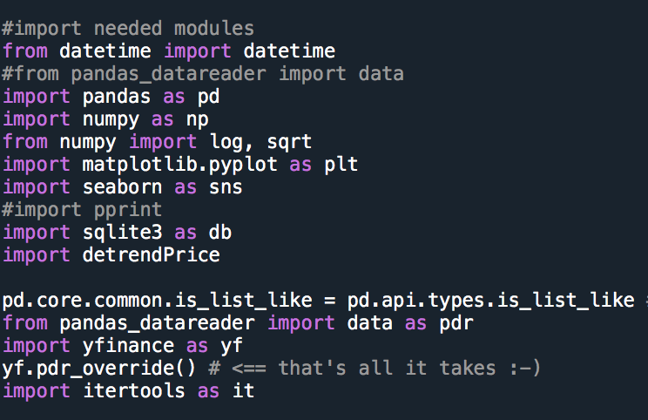
Set-up
We import the modules that we will need in the following steps.

Slide 13
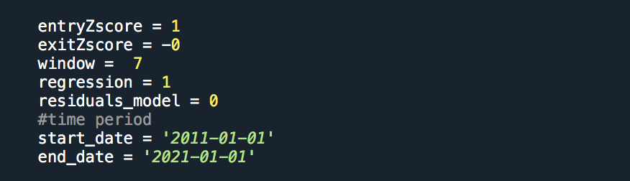
Parameters
We modify our seed code ReversionYesLoopMod_DISTRIBUTED.py. Here we set the parameters. The period we set is from January 1st, 2011 to January 1st, 2021.

Slide 14
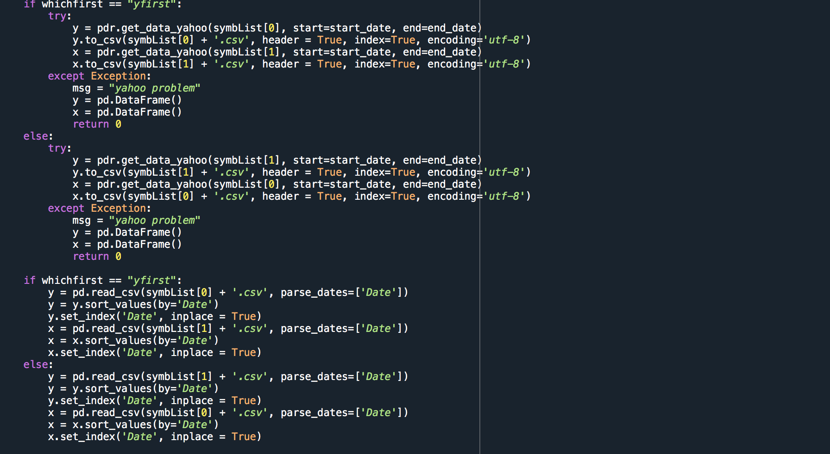
YFinance
We get the data from Yfinance.

Slide 15
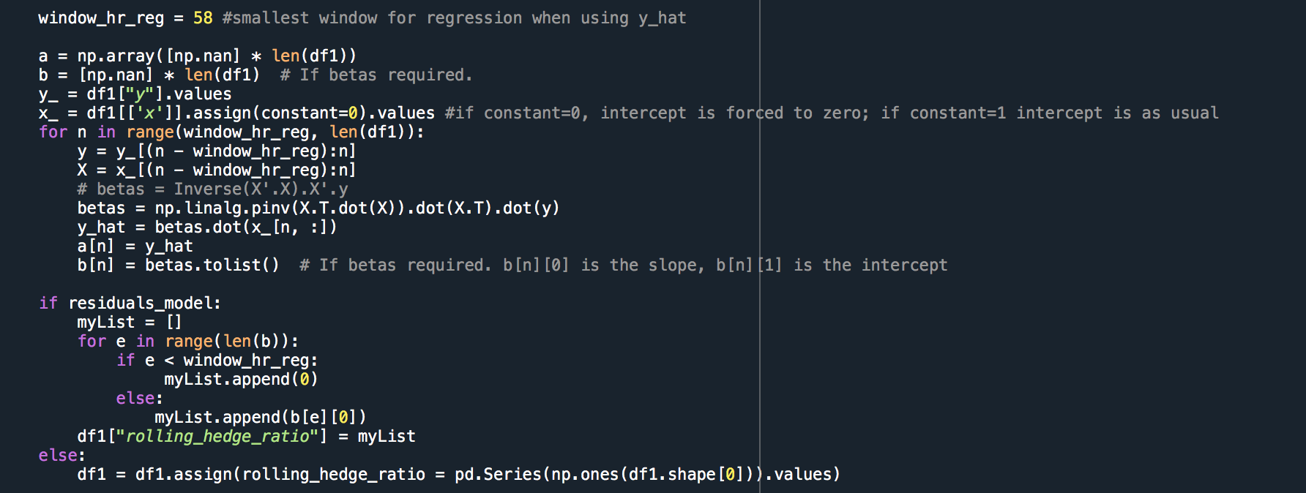
Hedge ratio
We regress the y variable against the x variable and get the rolling hedge ratio.

Slide 16
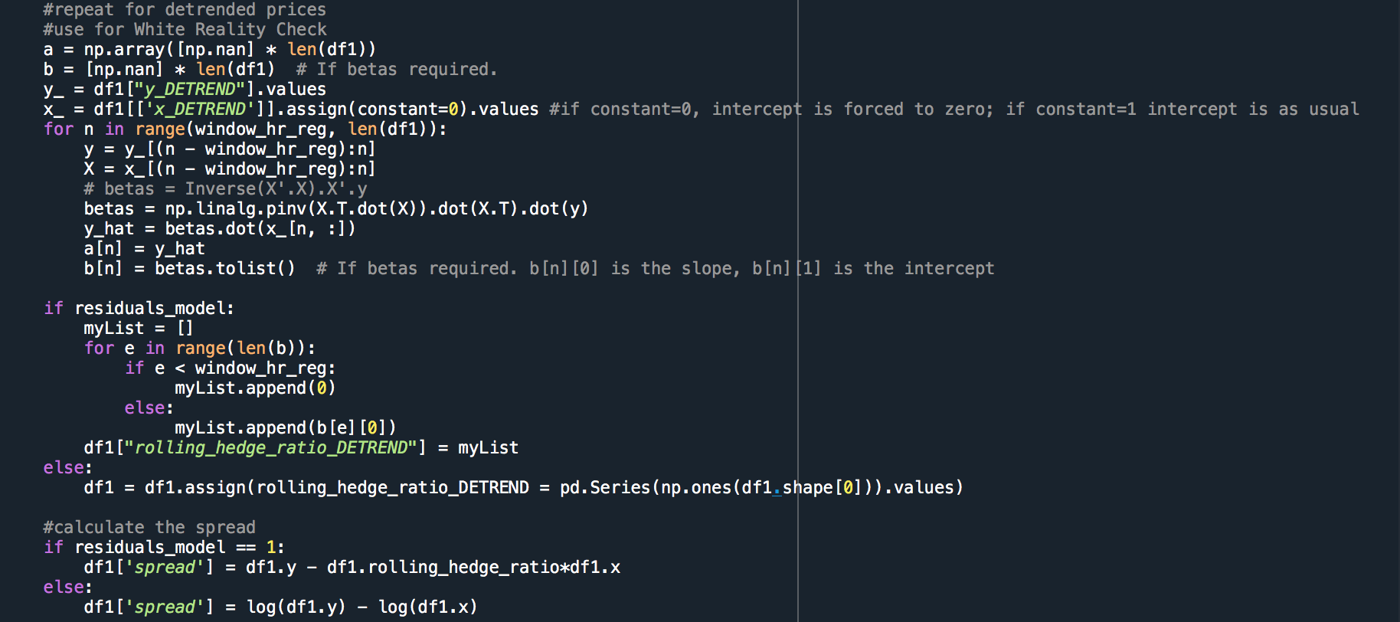
Hedge ratio with detrended price
We repeat the steps for calculating hedge ratio using the detrended price. We will use the results for the White’s reality check.

Slide 17
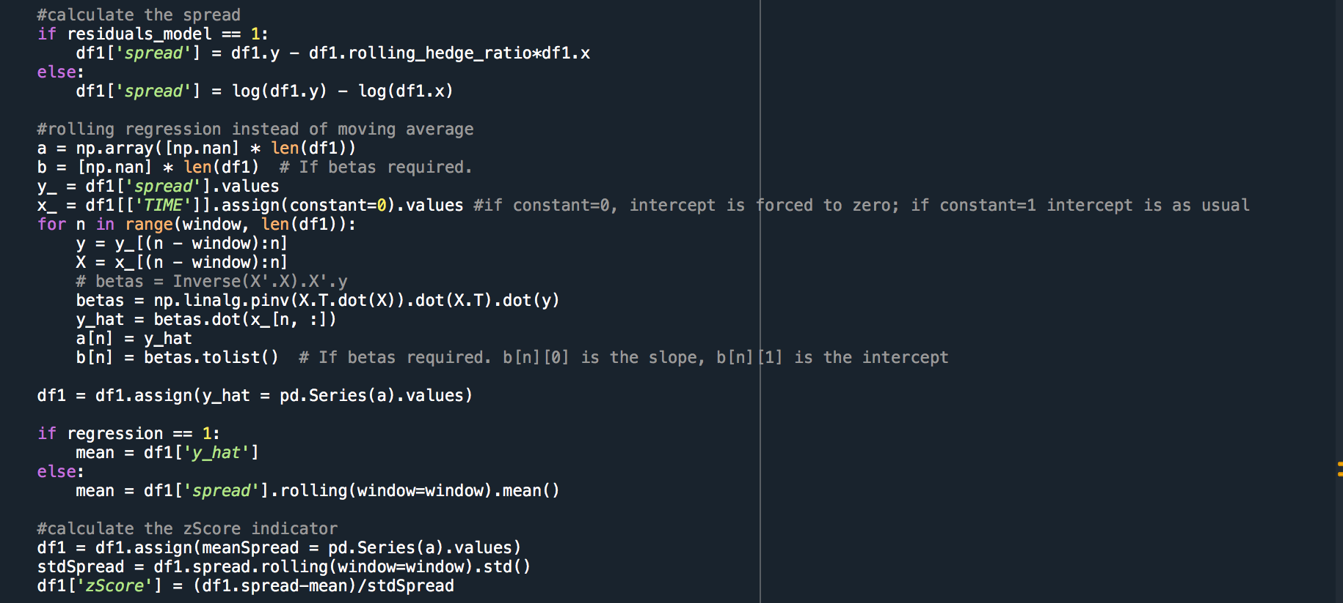
Spread & Z-Score
We calculate the spread and the Z-Score indicator using rolling regression. We modify the code in ReversionNoLoopMod_DISTRIBUTED.py for this part.

Slide 18
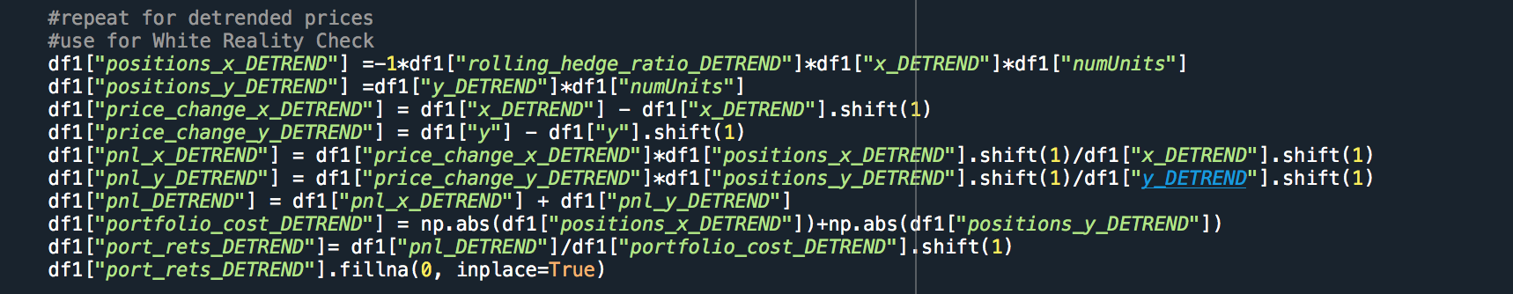
Positions
After calculating the num units long & short and the dollar capital allocation in each ETF, we repeat the steps for obtaining positions using detrended prices. We will use the results for the White’s reality check.

Slide 19
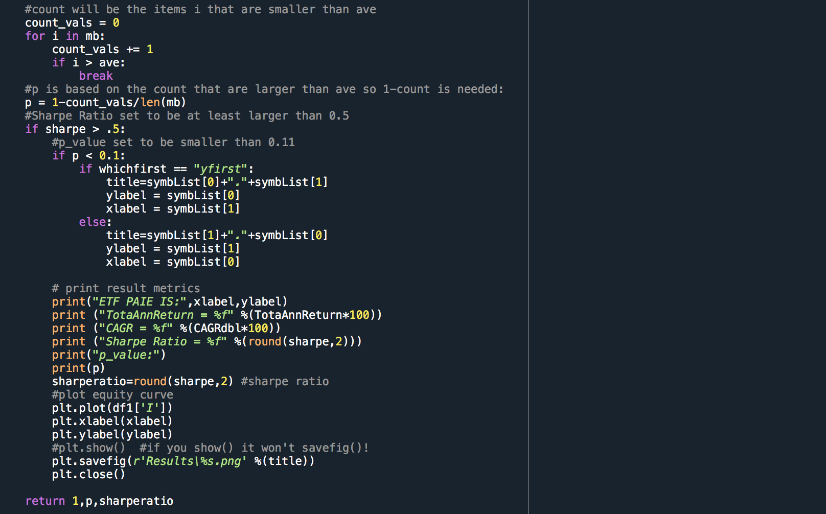
Sharpe ratio & p-value
We calculate the result metrics. We will use the Sharpe ratio and the p-value for evaluation for the choice of the “best” equity curve.

Slide 20
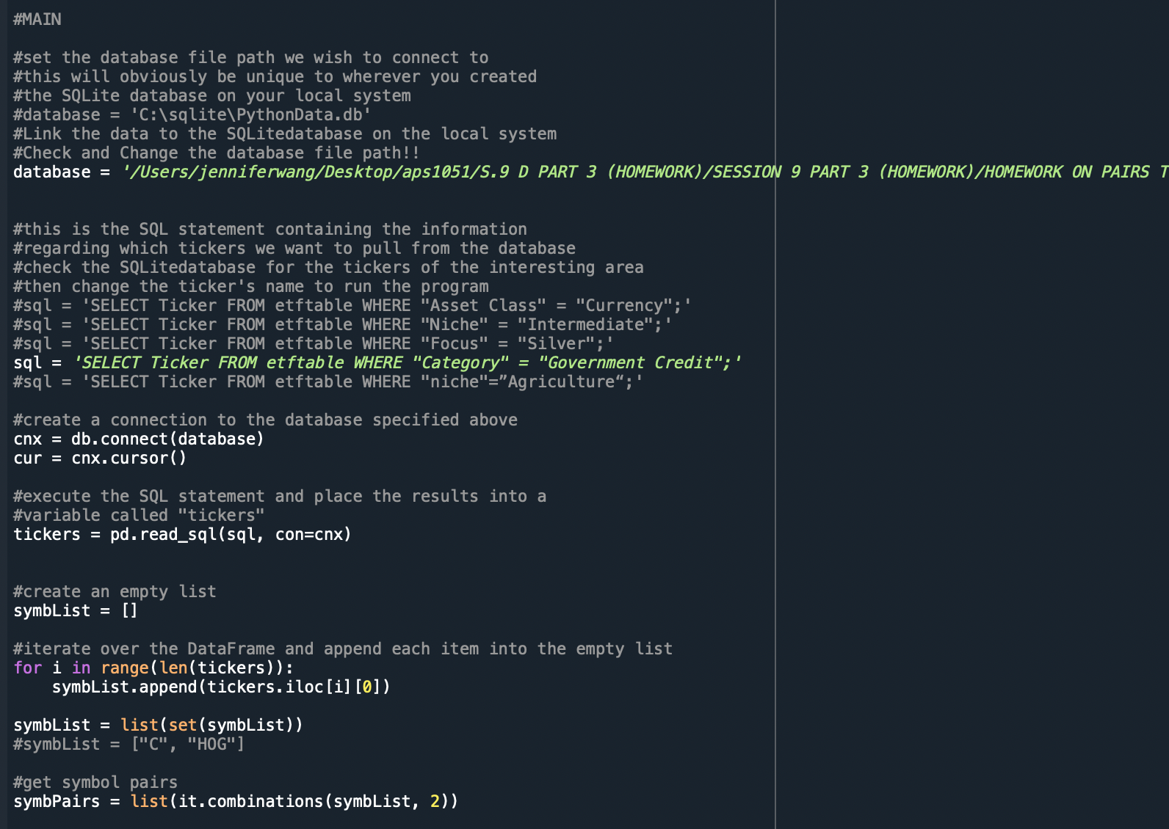
Database & Tickers
In this part, we can change the file path of the database and the ticker’s name to activate the program.
Link the data to the SQLite database on the local system. Remember to check and change the database file path for your own computer.
Check the SQLite database for the tickers of the interesting area, then change the ticker’s name to activate the program

Slide 21
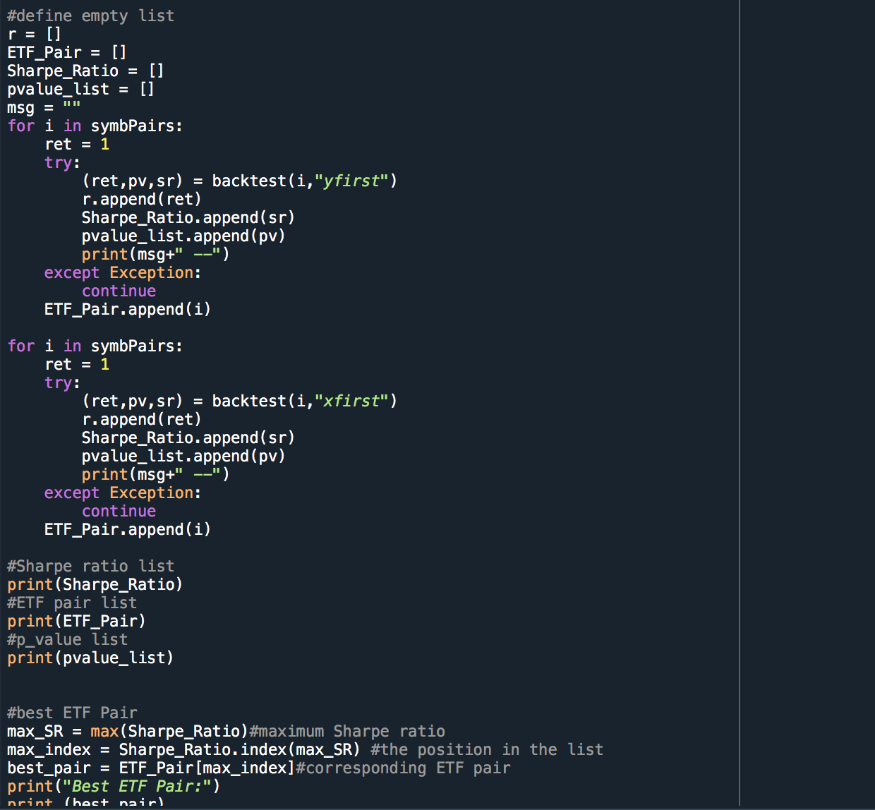
Results
We create these empty lists to store our results and using the Sharpe ratio to find the pairs of ETF with the good equity curves and select the pair of ETF with the best equity curve.

Slide 22
Results
Database
Tickers Selected
Best ETF pairs and their Equity Curves
Metrics of Results

Slide 23
Our group used the DB Browser for SQLite to browse data from PythonData.db from the sqlite folder provided in Week 9.
For the program, we tested five different tickers from the database:
Focus = Silver
Focus = Convertibles
Focus = Chinese Renminbi
Niche = Agriculture
Category = Government Credit.

Slide 24
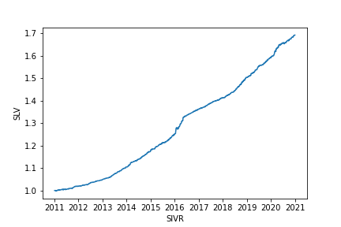
Results for Focus = Silver
The pair with the best equity curve where Focus = Silver is iShares Silver Trust (SLV) and ETFS Physical Silver Shares (SIVR).
Their corresponding Asset Class is Commodities; Category is Precious Metals; Focus is Silver, and Niche is Physically Held.

Slide 25
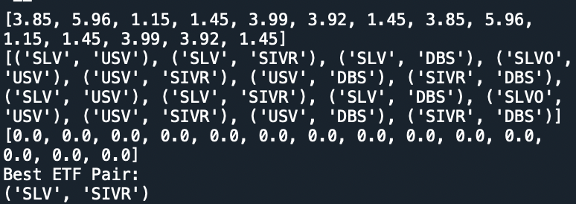
Metrics
The first list shows the Sharpe ratio of each possible pair. The second list is the corresponding pair names. The third list indicates the p-value of each pair. Finally the function will tell us what is the best ETF pair in the selected ticker.
For the best ETF pair SLV and SIVR, its corresponding Sharpe Ratio is 5.96 and its p-value is 0.0.

Slide 26
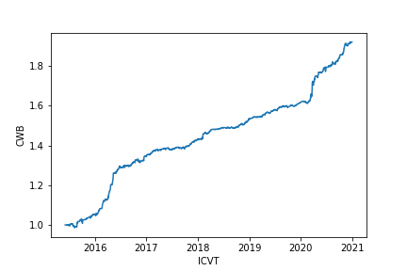
Results for Focus = Convertibles
The pair with best equity curve is SPDR Bloomberg Barclays Convertible Securities ETF (CWB) and iShares Convertible Bond ETF (ICVT).
Their corresponding Asset Class is Fixed Income; Category is Corporate; Focus is Convertibles and Niche is Broad Maturities.

Slide 27
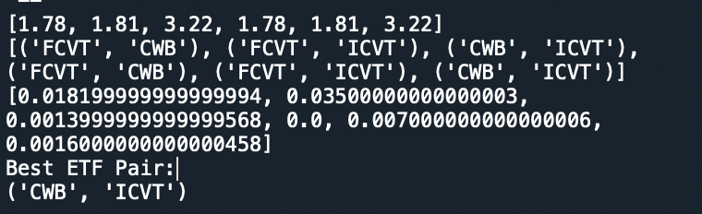
Metrics
For the best ETF pair CWB and ICVT, its corresponding Sharpe Ratio is 3.22 and its p-value is 0.0014.

Slide 28
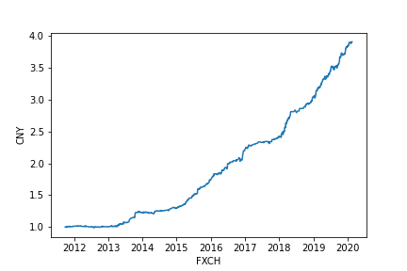
Results for Focus = Chinese Renminbi
The pair with best equity curve is Market Vectors Chinese Renminbi/USD ETN (CNY) and Invesco CurrencyShares Chinese Renminbi Trust (FXCH).
Their corresponding Asset Class is Currency; Category is Chinese Renminbi; Focus is Chinese Renminbi and Niche is Derivative.

Slide 29
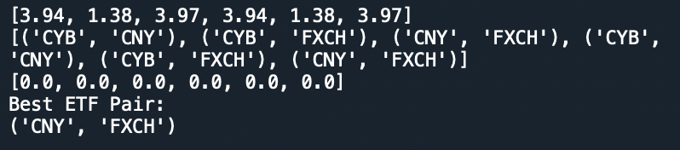
Metrics
For the best ETF pair CNY and FXCH, its corresponding Sharpe Ratio is 3.97 and its p-value is 0.0.

Slide 30
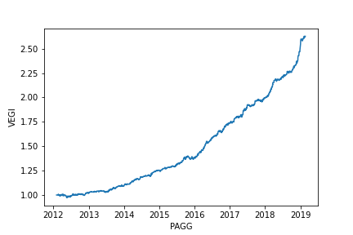
Results for Niche = Agriculture
The pair with the best equity curve is iShares MSCI Global Agriculture Producers ETF (VEGI) and Invesco Global Agriculture ETF (PAGG).
Their corresponding Asset Class is Equity; Category is Sector; Focus is Theme, and Niche is Agriculture.

Slide 31
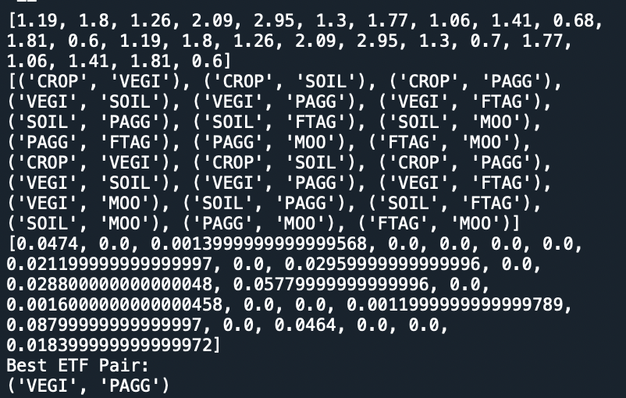
Metrics
For the best ETF pair VEGI and PAGG, its corresponding Sharpe Ratio is 2.95 and its p-value is 0.0.

Slide 32
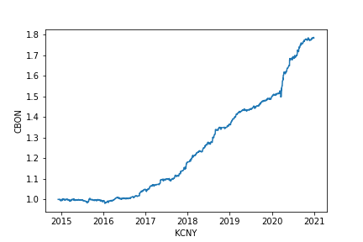
Results for Category = Government Credit
The pair with the best equity curve is VanEck Vectors ChinaAMC China Bond ETF (CBON) and KraneShares E Fund China Commercial Paper ETF (KCNY).
Their corresponding Asset Class is Fixed Income; Category is Government Credit; Focus is Investment Grade, and Niche is Broad Maturities and Ultra-Short Term.

Slide 33
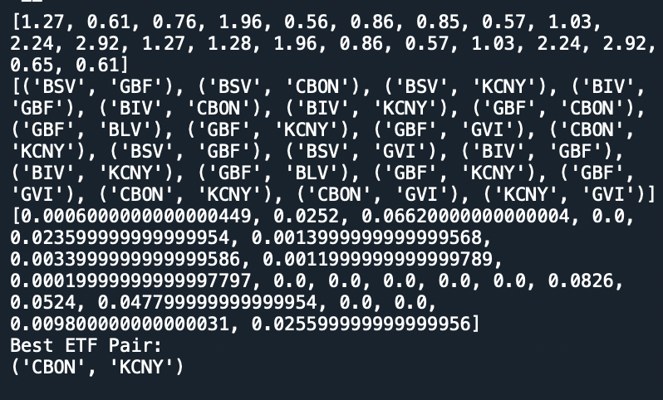
Metrics
For the best ETF pair CBON and KCNY, its corresponding Sharpe Ratio is 2.92 and its p-value is 0.0.

Slide 34
From the results of five different tickers, the best ETF pairs all obtain the highest Sharpe Ratios and p-values smaller than 0.01.
All of them have Sharpe Ratios greater than 1, which is considered “good” to investors.
All of them have p-values smaller than 0.1, which means the returns of the pairs are not obtained by chance.

Slide 35
Conclusion

Slide 36
In this project, our group uses ReversionYesLoopMod_DISTRIBUTED.py, ReversionNoLoopMod_DISTRIBUTED.py, detrendPrice.py and WhiteRealityCheckFor1.py as the seed codes in order to qualify the “good” Equity Curves in Loop Pairs Trading Program by using White’s Reality Check. The “good” equity curves are selected as the ETF pairs with Sharpe ratios larger than 0.5 and p-values smaller than 0.1.
Our group then used five different tickers to test the revised program, and the results returned by the program are the same as what we will select as the best equity curves manually. This means that the program we developed is efficient.

Slide 37
Future Developments
Build checking system
Multiple ways to find the best equity curve

Slide 38
We could build a checking system in python to let the program check whether the best equity curve it chose is the correct answer.
Instead of using the Sharpe ratio to select the best equity curve, we could let the function choose the best equity curve by comparing the cumulative returns or through the plots. According to the definition provided in the lecture, "great equity curve (meaning one showing high cumulative returns =, i.e., the curve is "up-trending" -- and a relatively low volatility -i.e., is not too bumpy.) (P36, APS 1051 W9 PART 1 PRESENTATION)". Thus, we can compare the cumulative returns of each pair to find the optimal choice. We can also design a function to find the plot with the highest positive cumulative returns or the steepest slope.
Applying the Variance Ratio Test, Augmented Dickey-Fuller Test, and Half-life Test directly to the best pair in the program.
Let the program leave a message when the selected theme does not have a good equity curve (i.e., there’s no stockpair in the chosen theme that have a Sharpe ratio larger than 0.5 or a p-value smaller than 0.1)

Slide 39
References
White, H. (2000). A reality check for data snooping. Econometrica, 68(5), 1097-1126.
Sharpe, William F.(1966). "Mutual Fund Performance." Journal of Business, January 1966, pp. 119-138.
PART 1 PRESENTATION (RATIONALE).pptx from Session 9
RegressionChannel2AssetTrading.pptx from Session 9

Slide 40
Thanks for Watching!

